Slide 1



EDA-Autistic Patients
PATHOLOGICAL DEMAND AVOIDANCE (PDA)

Slide 2
TEAM PROJECT
Team Members
Fatma Magdy Mohammed
Esraa Mohammed Abd El-ghany
FCI student at Assiut University
Big Data course​
Level 4​
FCI student at Assiut University
Big Data course​
Level 4

Slide 3



Slide 4
INTRODUCTION
Extreme Demand Avoidance (EDA)

Slide 5
Some doctors used it to describe a set of personal and behavioral traits shown by autistic people who tend to refuse to cooperate with others' requests .
The late Elizabeth Newson, professor of psychology at the University of Nottingham in the U.K., coined the term in 1983 to describe a syndrome in which a person resists and avoids the ordinary demands of life, even when complying is in their best interest.
INTRO
INTRO

Slide 6

EXTREME DEMAND AVOIDANCE QUESTIONNAIRE FOR ADULTS

Slide 7
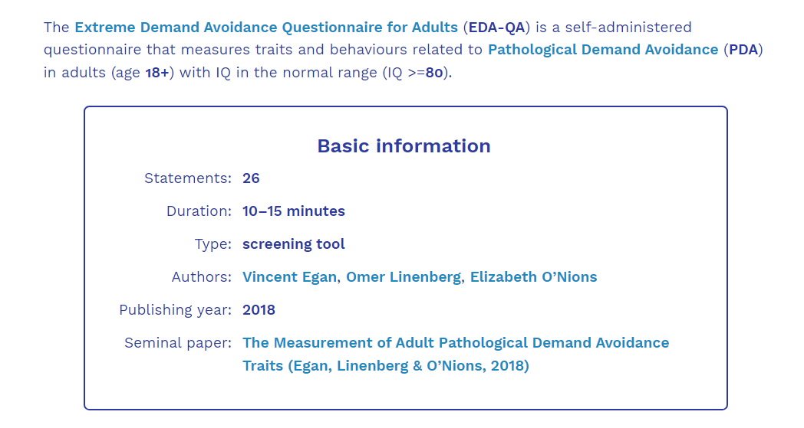
DATA: MAY 2023 - JULY 2023
Autistic Patients EDA

Slide 8
DATA VISUALIZATION
1
Classify and visualize Data
Demands often trigger avoidance behavior (e.g., distraction, excuses, withdrawal into role play). Pressure to comply can lead to escalation in emotional reactivity and behavior that challenges.

Slide 9
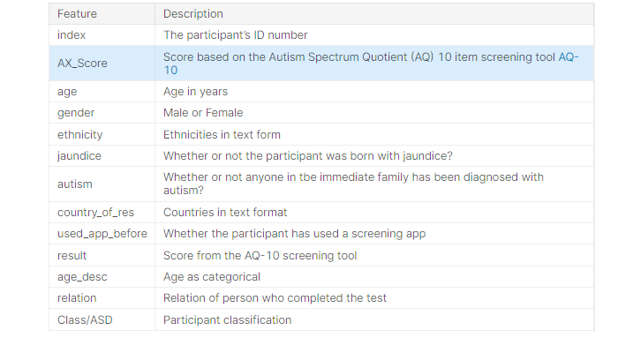
NEXT STEPS
Identified Data

Slide 10
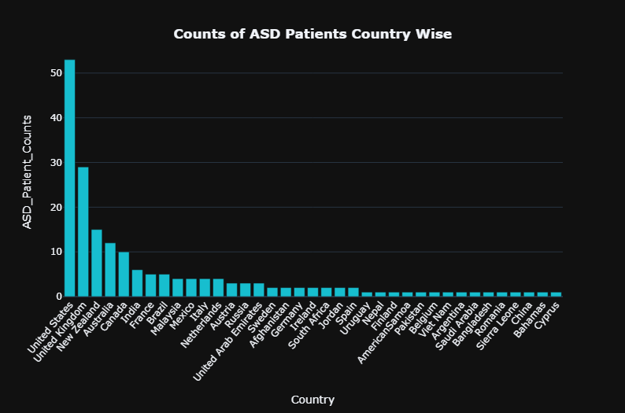
Rate of EDA
COUNTS OF ASD PATIENTS
7040
Patint
53 | United States | 1
29 | United Kingdom | 2
15 | New Zealand | 3
12 | Australia | 4
10 | Canada | 5
 | United States | 28%
COUNTS OF ASD PATIENTS COUNTRY WISE
37
country
NOTES
Main MRR drivers this month:
New checkout page
Reactivation campaign
New onboarding flow
COUNTS OF ASD PATIENTS COUNTRY WISE
Autistic Patients EDA

Slide 11
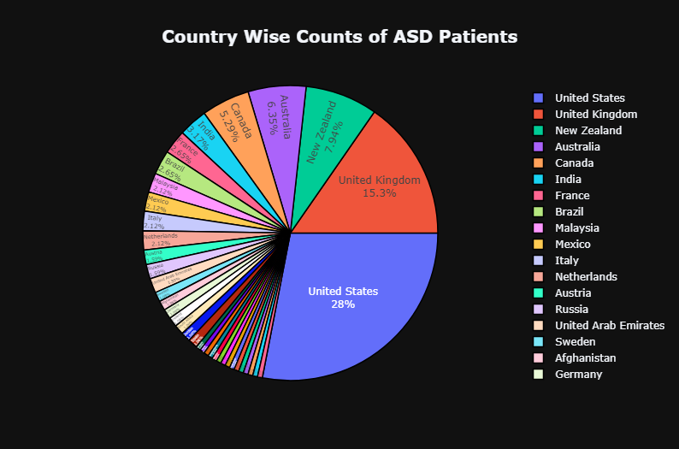
Autistic Patients EDA

Slide 12
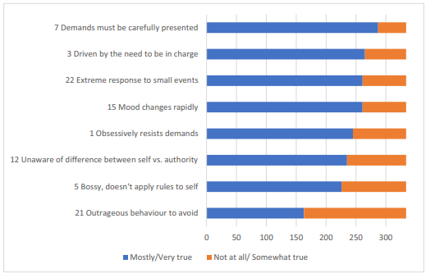
Demand-Specific & Socially Inflexible
NOTES
showed a similar relationship with EDA to Demand Specific Non-compliance and Socially Inflexible Non-compliance
82 | Mostly/Very true | 82%
18 | Not at all/ Somewhat true | 18%
 | Total | 100
NUMBER OF RESPONDENTS
Autistic Patients EDA

Slide 13
DATA VISUALIZATION
Implemented Queries
CRUD Operations
Pipeline Aggregation
MapReduce Function
Create new collections, documents and Queries then updated them and read it.
Perform complex data transformation on documents include :
$match, $group and $limit
involves two distinct phases: the map phase, which extracts relevant data from the input documents, and the reduce phase, which aggregates the data produced by the map phase

Slide 14
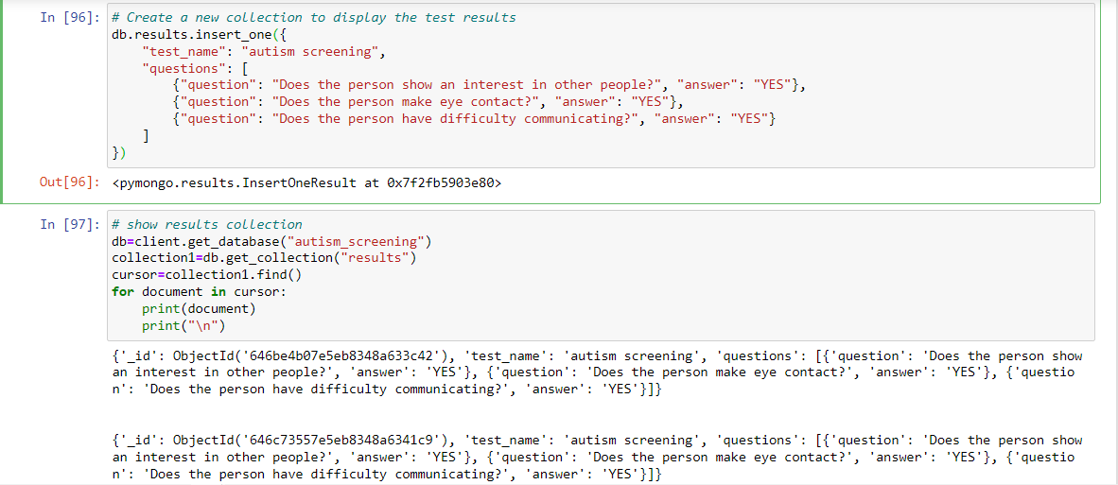

Slide 15

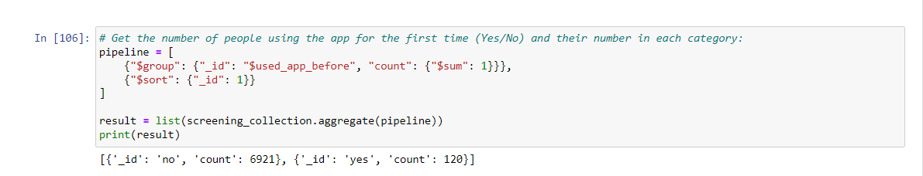
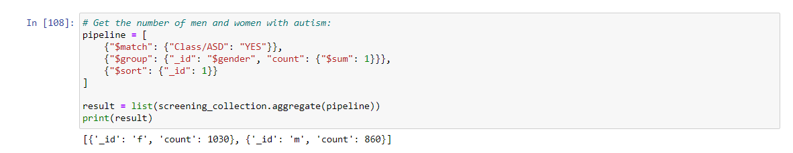
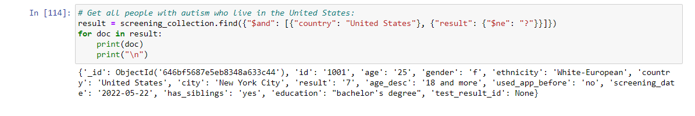

Slide 16
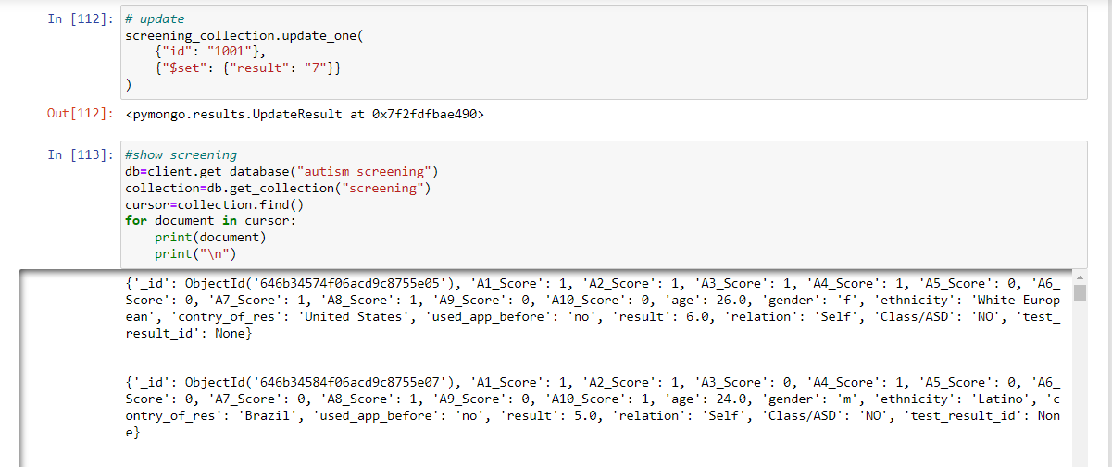
Autistic Patients EDA

Slide 17
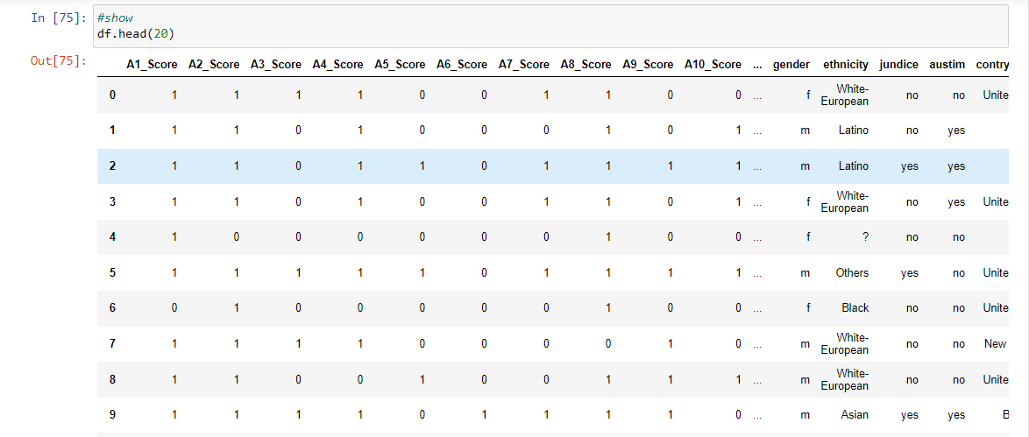
Data
Autistic Patients EDA

Slide 18

“
No two people on the spectrum are the same.
WWW.ALTOGETHERAUTISM.ORG

Slide 19
References
https://embrace-autism.com/eda-qa/#results
https://www.kaggle.com/code/muhammadshahrayar/autistic-patients-eda-classification-using-ann/notebook
https://embrace-autism.com/
Autistic Patients EDA
https://www.spectrumnews.org/news/pathological-demand-avoidance-in-autism-explained/
https://www.southlanarkshire.gov.uk/download/downloads/id/14113/understanding_extreme_demand_avoidance_eda_as_a_profile_of_the_autism_spectrum.pdf

Slide 20
Thank you!

